Slide 1
NODE.JS
(The Backend Of MERN Stack)
Lecture 36

Slide 2
Today’s Agenda
Interacting With MongoDB
What Is Schema ?
What Is Model ?
Defining Schema And Model
Using save()
Using create()
Examples

Slide 3
Interacting with mongodb
Once we have successfully connected to MongoDB we can then interact with it by saving and retrieving data.
This requires following steps:
Define a Schema
Using Schema define a Model
Using Model create an object
Call various methods of the object to interact with MongoDB

Slide 4
What is schema ?
Although MongoDB is famous for being schema-free which means that a collection can accept many different kinds of documents .
But this can allow junk data also to be inserted or updated.
To overcome this we must have a well defined format of our documents and this is done using Schema in Mongoose.

Slide 5
What is schema ?
A Mongoose schema defines the structure of a document and the types of data that can be stored in each field.
It provides a blueprint for creating MongoDB documents and ensures that data is stored in a consistent format.

Slide 6
How to define a schema ?
To define a Mongoose schema, we can use a special constructor function called mongoose.Schema.
The schema defines the fields for our MongoDB documents and their respective data types.

Slide 7
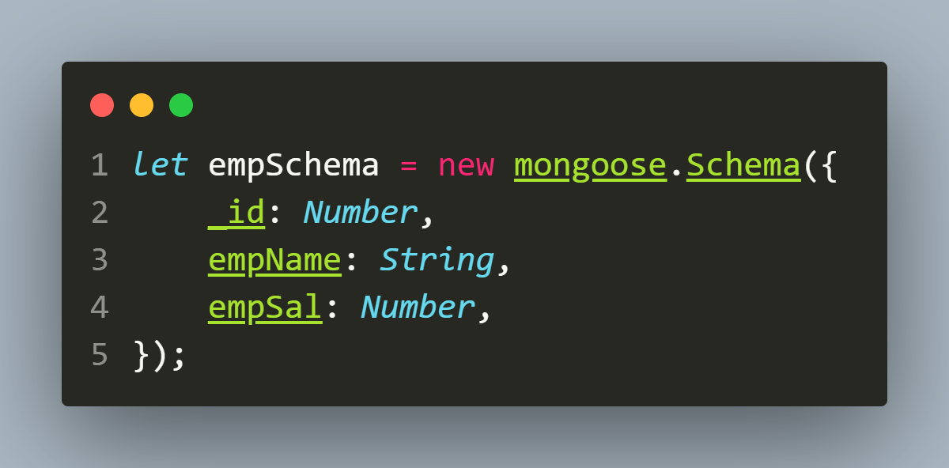
How to define a schema ?
Syntax:
let <varName>=new mongoose.Schema( {
<fieldname>:<data_type>,
<fieldname>:<data_type>…
});
Example:

Slide 8
What is model ?
Once we have defined our schema, we can create a Mongoose model to interact with the MongoDB database.
A Mongoose model is a constructor function that provides an interface to interact with a MongoDB collection.
It allows us to perform CRUD (create, read, update, delete) operations on the MongoDB documents that are based on our schema.

Slide 9
How to define a model ?
To create a Mongoose model, we can use the mongoose.model() method.
Syntax:
let <varName>=mongoose.model(“<name>”,<schema> );
Parameters:
name: model name
schema: schema to use
Return Value:
This method returns a model object associated with name

Slide 10
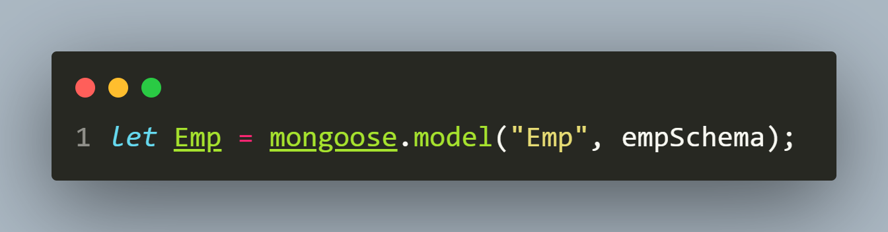
Sample Code
Example:

Slide 11
Special note
The first argument passed to the model should be the singular form of our collection name.
Mongoose will automatically change this to the plural form, transform it to lowercase, and use that for the database collection name.
Thus, for the example in previous slide, the model Emp is for the emps collection in the database.

Slide 12
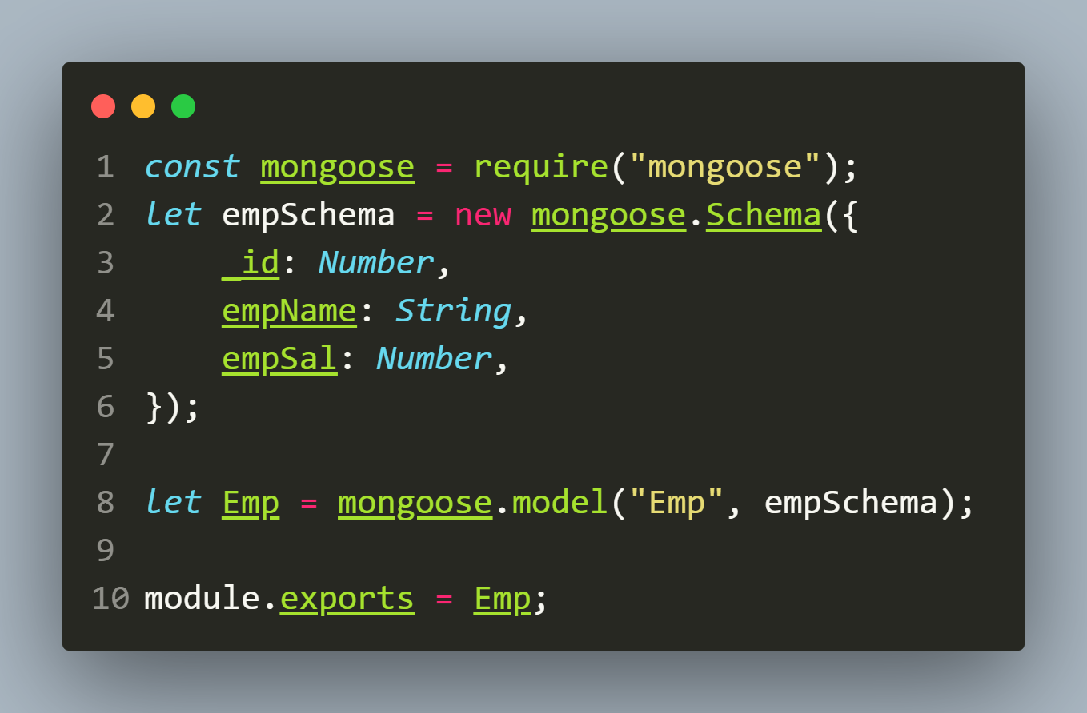
Complete code for schema-model
empModel.js

Slide 13
Adding data in mongodb
To add data/insert document in our MongoDB database using Mongoose, we take 2 steps:
Create a new object using Model.
Call the save() method on the newly created object.

Slide 14
Syntax of save()
Syntax:
<model_object>.save()
The save() method is asynchronous, so it returns a promise that can be used with then()/catch() or async/await to get the status of the operation.

Slide 15
Exercise 68
Write an Node-Mongoose application for the following tasks:
Connect to a mongodb database called hrdb.
Save records of 2 employees as shown below.
Finally , print the acknowledgement whether saving was successful or not
_id | empName | empSal
101 | Amit | 50000.0
102 | Sumit | 60000.0

Slide 16
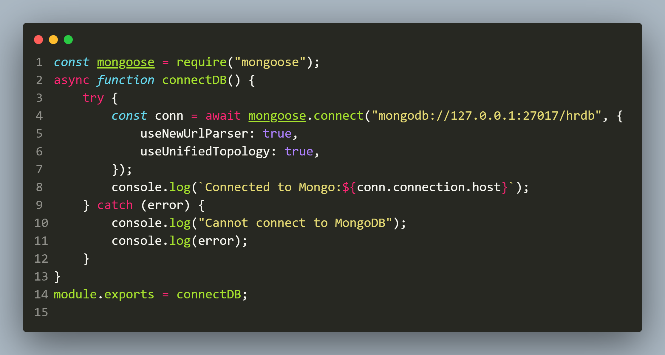
Solution(db.js)

Slide 17
Solution(empModel.js)

Slide 18
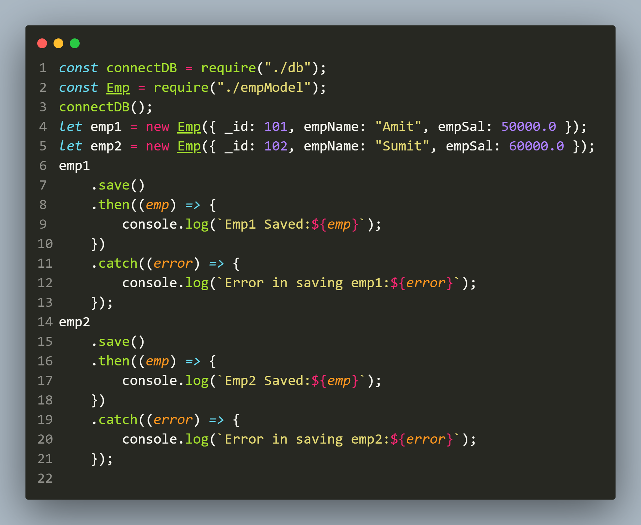
Solution(app.js)

Slide 19
output
What is __v ?
The “__v” field in Mongoose is the versionKey property set on each document when first created by Mongoose.
It contains the internal revision of the document and the default is __v.

Slide 20
A very special point
The previous code worked perfectly fine.
But have you found any problem with it?
We can save a document only after we are connected to the MongoDB and connection to MongoDB is done by connect() method which runs asynchronoulsy.

Slide 21
A very special point
This means when the save() method gets executed, the connection must have already been established.
This means we should run the model and save methods from inside the callback of the mongoose connect() method.

Slide 22
A very special point
So the code we have here should not work because we put the model and save methods outside the callback of connect() method and JS engine will not wait for the connection to be established before executing the save method.

Slide 23
A very special point
But this is not the result we got.
The new document has been saved successfully.
So how did this happen?
Why an incorrect program produced the correct result?

Slide 24
answer
By default, mongoose buffers the model function which means Mongoose holds the execution of the model method until the connection has been established.
This is why the save() method can work outside the callback of the connect() method.

Slide 25
Can we turn off this buffering ?
We can turn off the buffering feature by turning off the bufferCommands globally using the following code:
mongoose.set('bufferCommands', false);

Slide 26
Improvements to app.js
We can improve the previous code in app.js by creating a function called saveToDB()
We can then write all the code to save the record and get the acknowledgement in that function.
Finally we can call saveToDB() passing it the emp object to be saved.

Slide 27
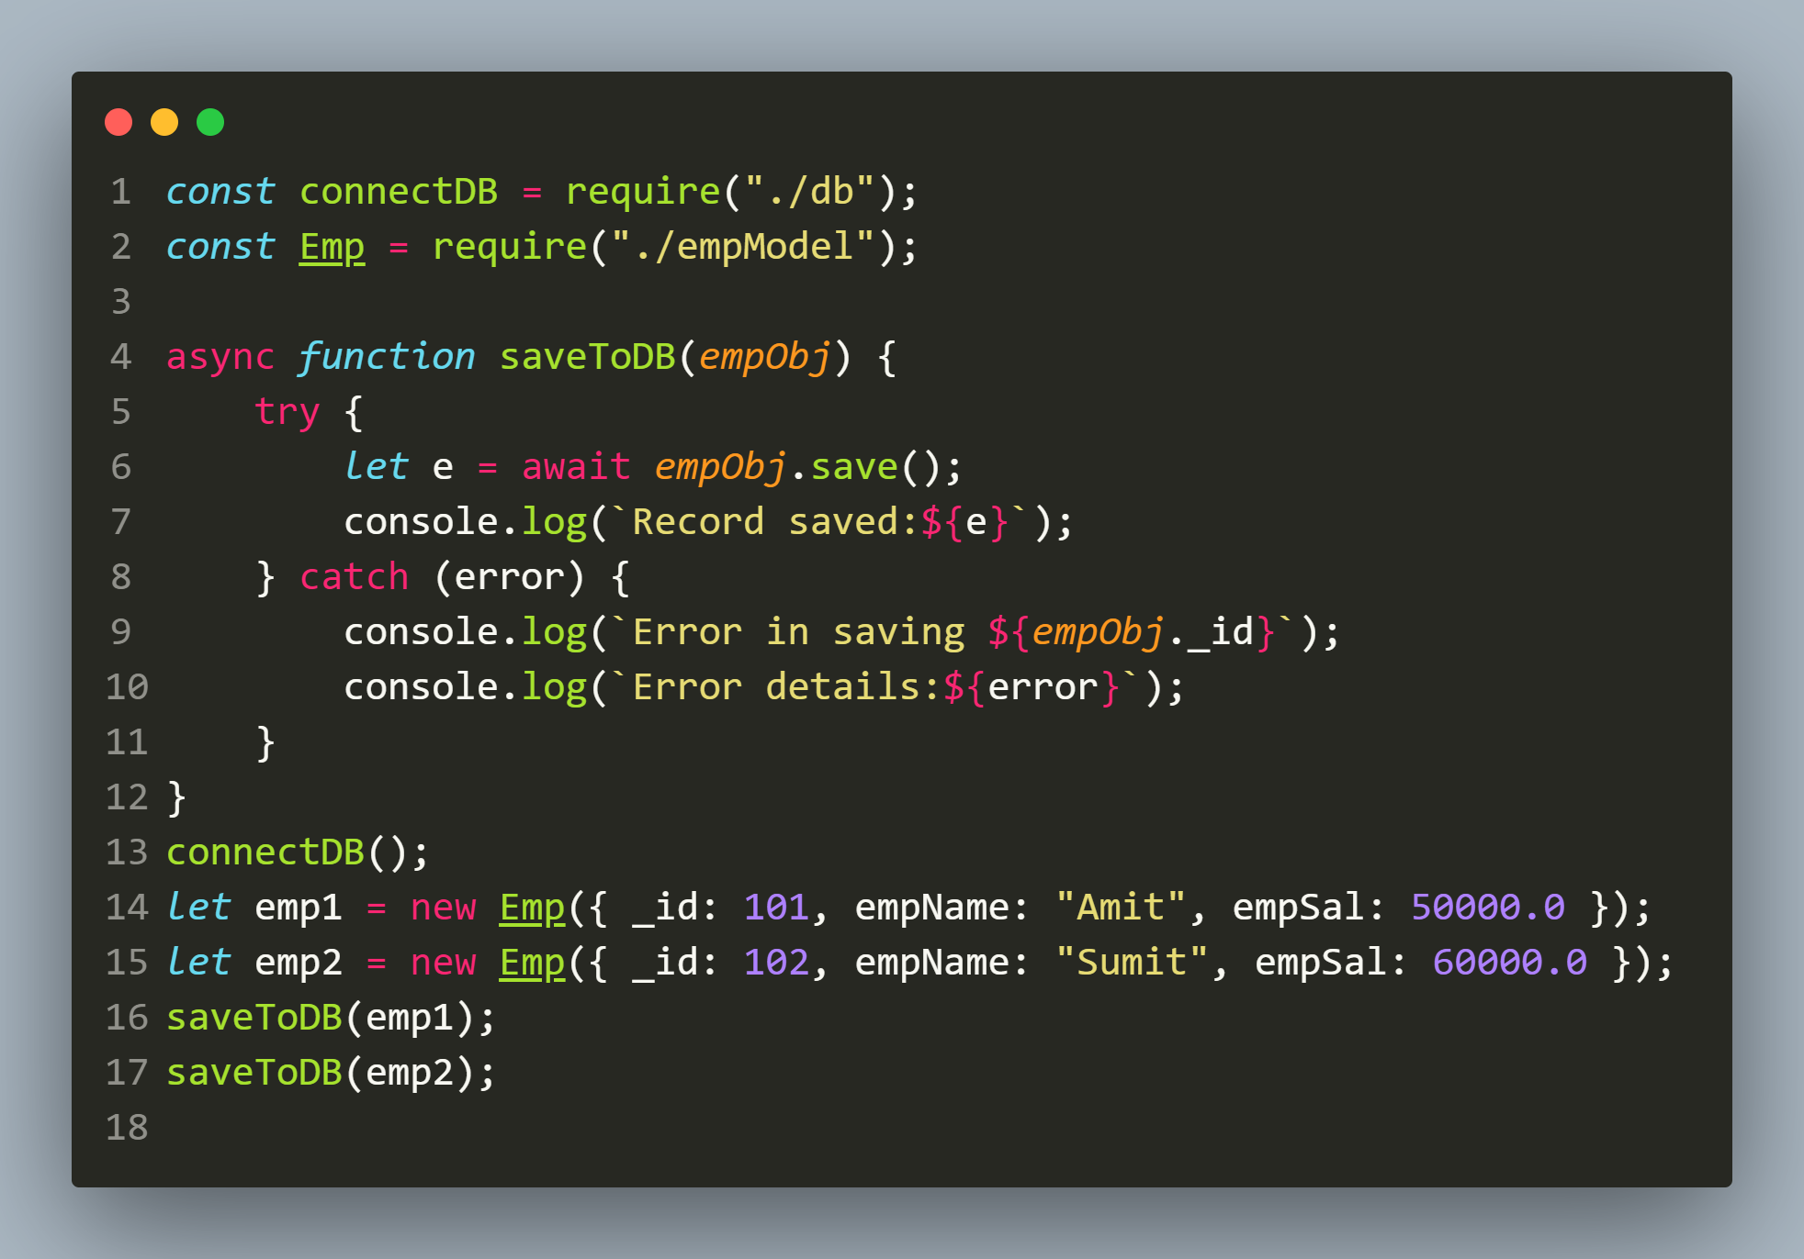
improved(app.js)

Slide 28

output

Slide 29
Using the create() method
Mongoose models have a create() method that can also be used to create new documents.
The create() method is a thin wrapper around the save() method.
The most common reason for using create() is that we can conveniently save multiple documents with a single function call by passing an array of objects.

Slide 30
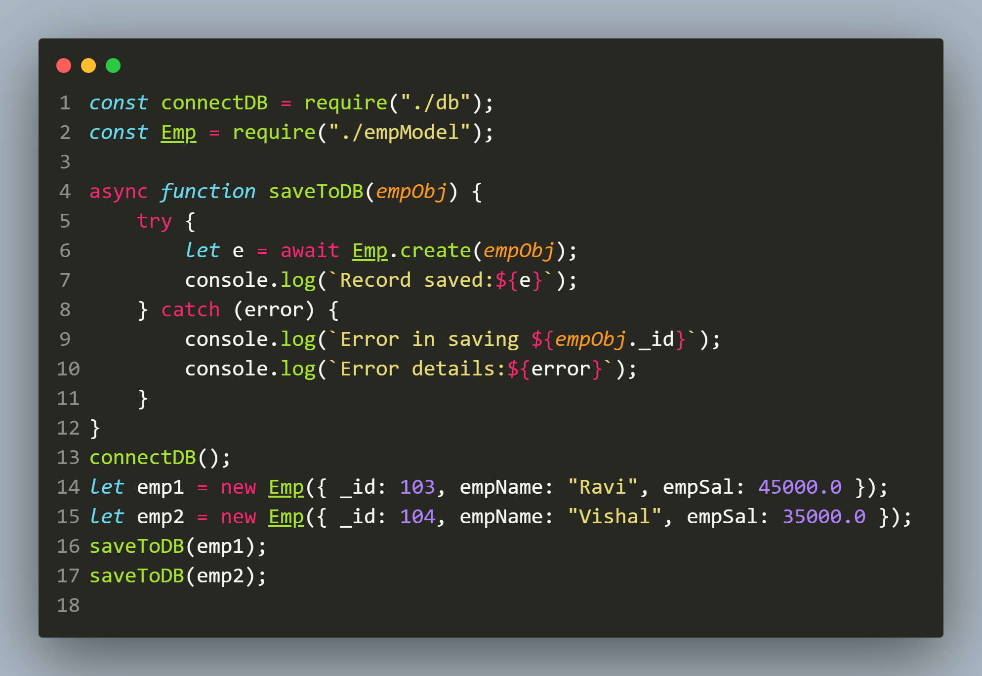
SAVING SINGLE OBJECT USING create()

Slide 31

output

Slide 32
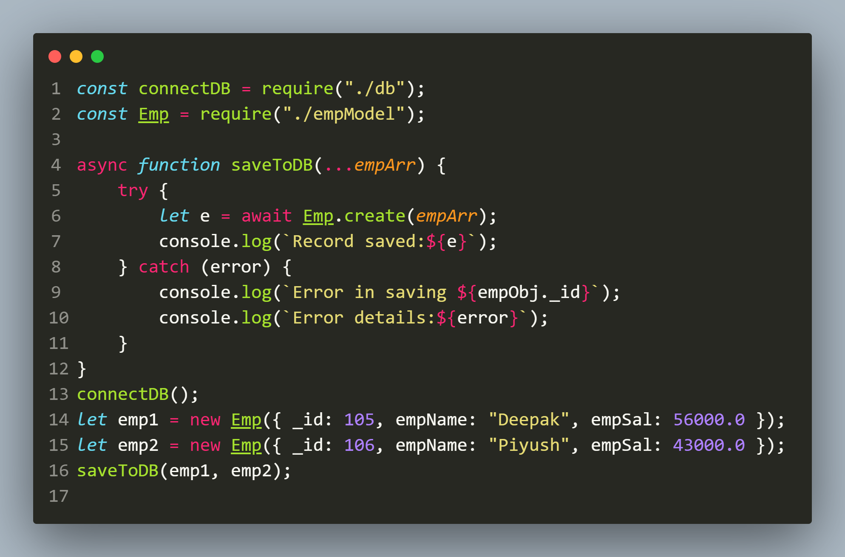
SAVING ARRAY USING create()

Slide 33
output

